Slide 1
《英语国家社会与文化入门》(下册）
The Society and Cultures
of Major English-Speaking Countries
An Introduction
(Book Two)

Slide 2
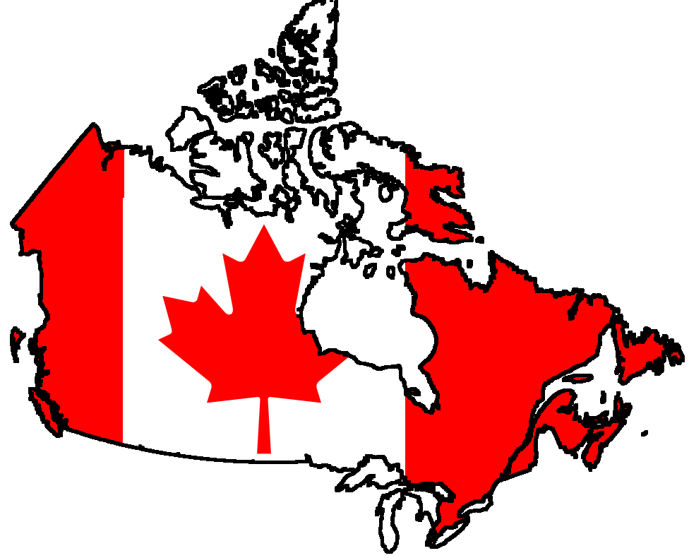
Canada Unit 18 The Government and Politics of Canada
Welcome to Canada Bienvenue au Canada

Slide 3
Quiz
Give the English and a brief explanation for the following:
1 议会制民主
2 加拿大总督
3 加拿大议会
4 加拿大保守党
5 约翰·克雷蒂安

Slide 4
Focal Points
Canada’s political system
“peace, order and good government”
tolerance of different values and customs
English-speaking Canada
French-speaking Canada
Canada’s system of government
the Governor General
the federal government
the House of Commons
the Senate
the Liberal Party
the Conservative Party
the Bloc Quebecois
the Reform Party
Pierre Trudeau
Brian Mulroney
Jean Chretien
Stephen Harper

Slide 5
This Unit Is Divided into Four Sections
Historical background
Structures of government
III. The Federal Political Scene
IV. Canadian Prime Ministers

Slide 6
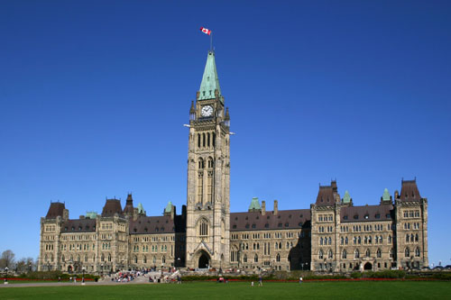
I. Historical Background
Two major foreign influences:
-- former colony of Britain
-- reaction to the political development in the United States
Parliament Hill, Ottawa

Slide 7
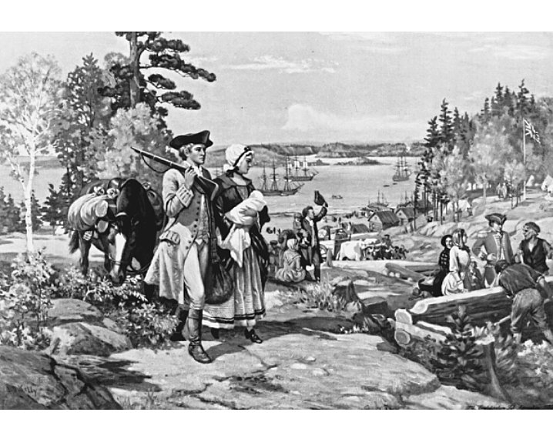
I. Historical Background
United Empire Loyalists
During and after the American Revolution, people who remained loyal to the British Crown fled north, hoping to build a British North America in what would soon be known as Canada.
United Empire Loyalists landing
at the site of Saint John, New Brunswick,
1783.

Slide 8
I. Historical Background
Provincial governments
Were persuaded to join into the Canadian “confederation” after special favors were granted. (eg. British Columbia)
Operate on the same model as the federal government.
-- Premier
-- Legislative assembly
Manage the local economy, education and health systems.

Slide 9
I. Historical Background
Political aspirations
Influenced by American ideas, eg. freedom of speech and freedom of information
Different from the Americans:
-- “life, liberty and the pursuit of happiness” (the U.S.)
-- “peace, order and good government” (Canada)
The well-being and liberty of individuals must sometimes be sacrificed for the greater good of the community. (eg. the right to own and use guns; attempts to reconcile Quebec and the rest of Canada)

Slide 10
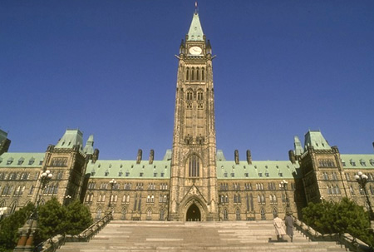
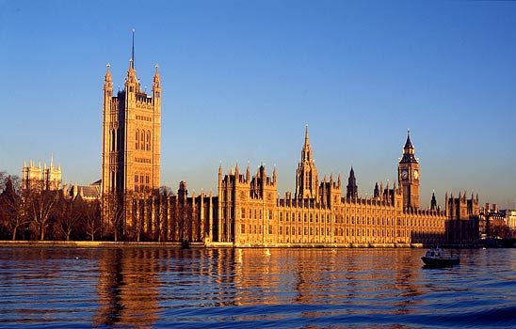
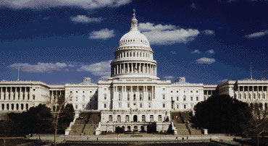
II. Structures of Government Canada’s Political Traditions
British Parliamentary democracy
American Federalism

Slide 11
II. Structures of Government
Features of Canadian political system
A monarchy
Official head of state -- the Queen (represented by Governor General) playing a ceremonial role
A federation of ten provinces and three territories
First to combine federalism with parliamentary democracy

Slide 12
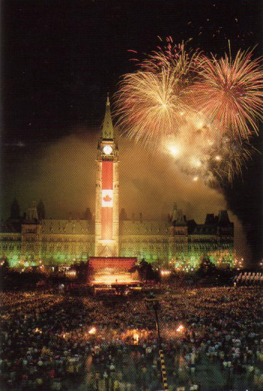
II. Structures of Government
The Parliament
The House of Commons
(The Lower House)
The Senate
(The Upper House)
Celebrating Canada Day at the Parliament Hill

Slide 13
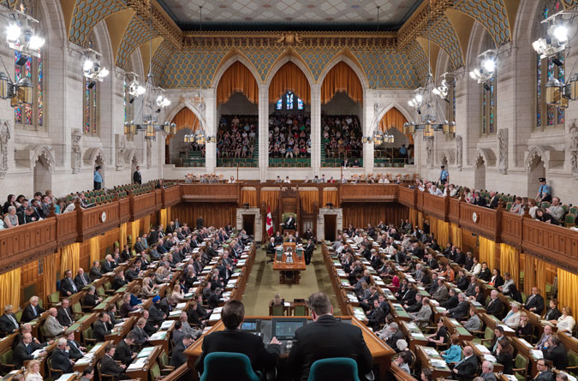
II. Structures of Government
The House of Commons
MPs elected at electoral districts based on population rather than geographic size
Currently 308 seats
Ontario and Quebec have the most seats
Fewer seats and thus less represented in sparsely populated regions

Slide 14
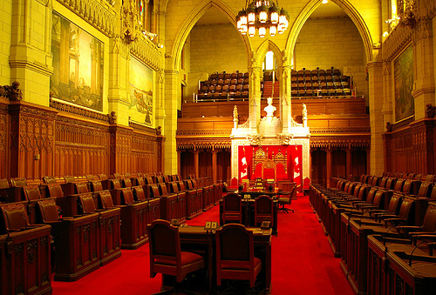
II. Structures of Government
The Senate
NOT elected
Appointed by the Governor General, recommended by the Prime Minister
Picked to represent the regions more equally
Calls for reform to make it an elected body

Slide 15
II. Structures of Government
Prime Minister and Cabinet
The party that wins the most seats forms the government
The party leader becomes Prime Minister
The Prime Minister chooses senior MPs from his/her party to form the Cabinet

Slide 16
III. The Federal Political Scene
Political Parties
The Conservative Party
The Liberal Party
New Democratic Party (NDP)
Bloc Quebecois (BQ)

Slide 17
III. The Federal Political Scene
Political Parties
* The longest ruling parties: The Liberals (66 years) and the
Conservatives (more than 30 years)
* The party that was not in power always formed the official
opposition to the government
* Regional differences in favor of the parties –
e.g. Western provinces and Quebec seldom voted Liberals
* The Progressive Conservative Party and the Canadian
Alliance merged into the Conservative Party in 2003.

Slide 18
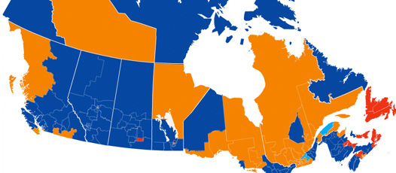
III. The Federal Political Scene
A colour-coded map produced by the CBC shows Canadians' party preferences by
province and riding. Blue equals Conservative, orange NDP, red Liberal, and light blue
Bloc Quebecois.
See more at: http://www.thecanadaguide.com/political parties#sthash.byUygwiE.dpuf

Slide 19
III. The Federal Political Scene
The rise of regional parties
Causes: 1. lack of representation in different regions
2. feelings of dissatisfaction of having little influence
on federal policy making
e.g. In the 1993 election, the Progressive Conservative Party only won two seats.

Slide 20
III. The Federal Political Scene
The rise of regional parties
Examples:
The Bloc Quebecois -- a coalition of MPs from the mainly French-speaking province who were dedicated to separation from Canada.
The Reform Party -- winning enough seats in the 1997 election to become the country’s official opposition. It has its strongest support in the western provinces and no Reform MPs were elected in Central Canada.

Slide 21
III. The Federal Political Scene
Problems and Challenges
Regional pressures threaten to tear the country apart.
The Bloc Quebecois insists that Quebec be granted special rights and privileges and a “distinct society” status
The Reform Party insists that all Canadians are equal and that no one should enjoy special.
The Conservative and Liberal governments have struggled to find ways to make Quebec happier about being a part of Canada.

Slide 22
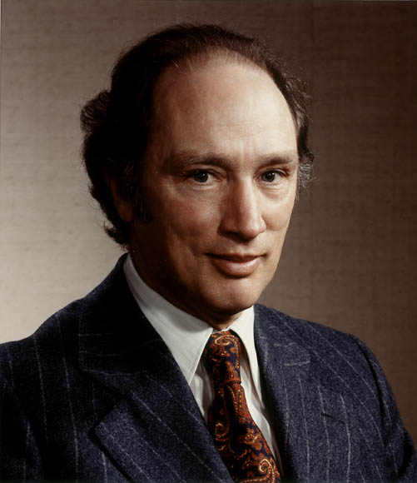
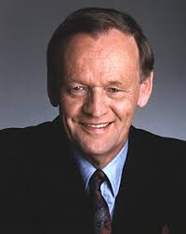
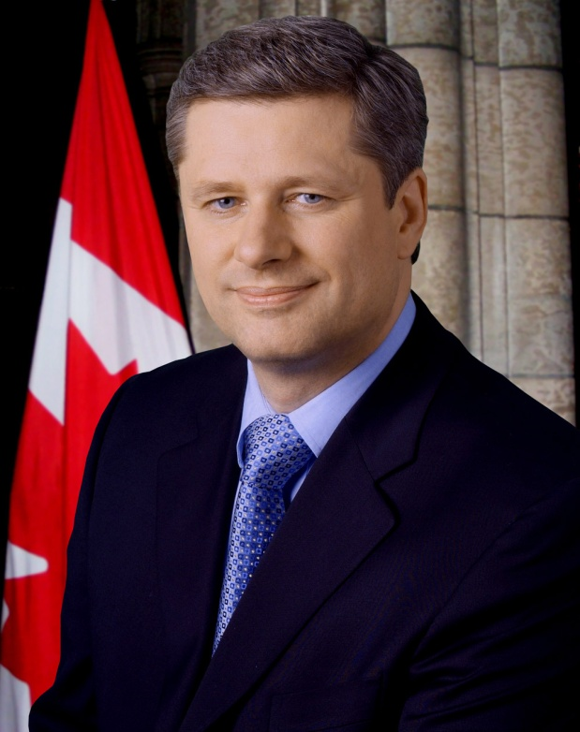
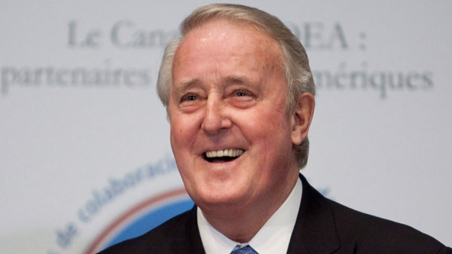
IV. Canadian Prime Ministers
Pierre Trudeau Jean Chretien Stephen Harper
Brian Mulroney

Slide 23
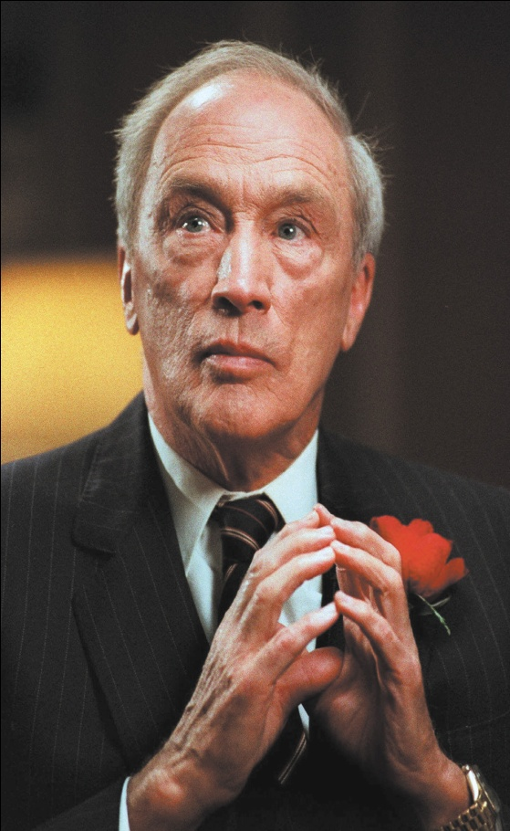
IV. Canadian Prime Ministers
Pierre Trudeau
served as PM from 1968 to 1984
a francophone with a vision of a powerful
and united Canada
introduced bilingualism and worked very
hard to bring English and French Canada closer together
raised Canadians’ awareness of French
heritage and saw this element as one of the
things that made Canada unique

Slide 24
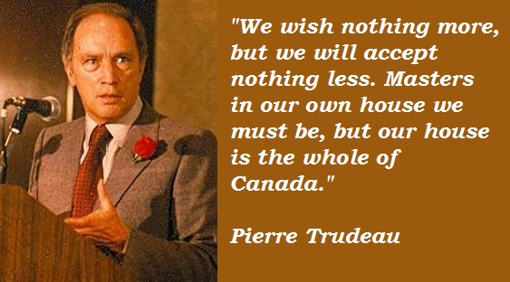
IV. Canadian Prime Ministers
Pierre Trudeau
make Canada completely independent of Great Britain
introduced the Constitution Act (1982) which gave Canada complete legal independence.

Slide 25
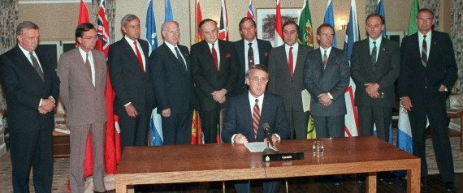
IV. Canadian Prime Ministers
Brian Mulroney
led the Conservative government between 1984 and 1993
from Quebec’s English-speaking community background
introduced the Meech Lake Accord which would recognize Quebec as a “distinct society”, but some some provincial governments objected, thus failed in 1990
Meech Lake Accord

Slide 26
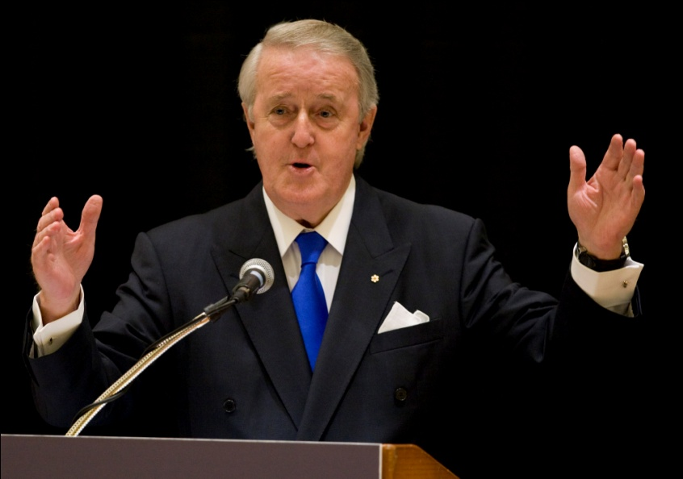
IV. Canadian Prime Ministers
Brian Mulroney
signed a free trade agreement with the U.S. (1988), removed trade barriers between the two countries, and paved way for NAFTA (the North American Free Trade Agreement)
introduced the Multiculturalism Act (1988)

Slide 27
IV. Canadian Prime Ministers
Multicultralism
Trudeau’s idea (1971) who announced a policy affirming Canada’s support of the various ethnic, racial and religious groups in the country.
this idea was expressed again in the Canadian Charter of Rights and Freedoms (1982)
the Multiculturalism Act (1988)

Slide 28
IV. Canadian Prime Ministers
Jean Chretien
from Quebec’s French speaking community background
his liberal government served Canada for 10 years
an ardent supporter for bilingualism and multiculturalism
strongly opposes Quebec sovereignty movement
passed the Clarity Act after the 1995 Quebec Referendum

Slide 29
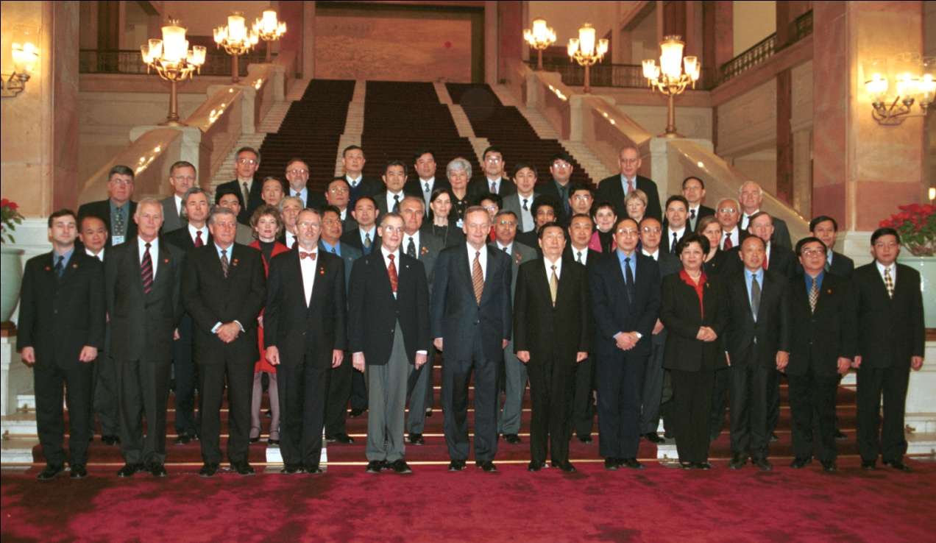
IV. Canadian Prime Ministers
Jean Chretien
promoted trade relations between Canada and China by leading Team Canada to visit China
2001 Team Canada

Slide 30
IV. Canadian Prime Ministers
Similarities of Trudeau, Mulroney and Chretien
all were born in Quebec
all educated as lawyers
all shared the vision of a strong, united Canada and have paid special attention to the cultural diversity of the nation

Slide 31
IV. Canadian Prime Ministers
Stephen Harper
came into office in 2006 as leader of the Conservative Party
attempted to reform the Senate from an appointed body into an elected one
passed a motion to recognize Quebec as a nation “within a united Canada” (2006)
an ally to the United States in the war on terror
cooled down with China but warmed up in his second term since 2008

Slide 32
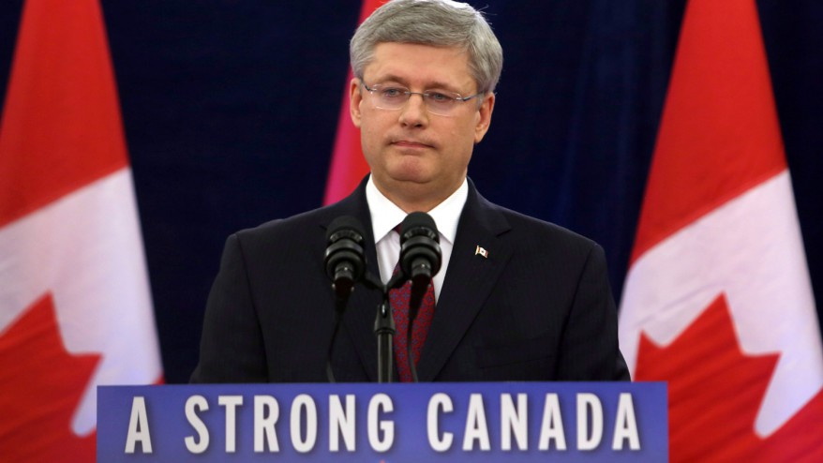

Slide 33
Questions for Discussion
Discuss the similarities and differences in the government systems between the United Kingdom, the United States and Canada.
What are some of the characteristics of the Canadian party system?
What are the major contributions of the four prime ministers mentioned in the unit?
Why do you think the author says that Canada has avoided the worst excesses of intolerance and prejudice?

Slide 34
The End
高等教育出版社
2015

